Slide 1
Dealing with Data and Visualization
Steve Johnson, PhD, Assistant Professor, Institute for Health Informatics, University of Minnesota
June 5, 2019

Slide 2
Dealing with Data
Data Acquisition
Data Pre-processing
Data Quality
Cleaning
Missing data
Feature development
Phenotyping
Natural Language Processing (NLP)
Visualization

Slide 3
Data Acquisition
Data Acquisition
Data requests and IRB
Documenting expectations, independent and dependent variables
Asking for too much vs too little data
De-identification
Terminology mapping
Data extraction
Flat files (CSVs) vs Data Marts
Data dictionaries
Re-extraction / data updating

Slide 4
Data Quality
Data Quality Dimensions
Correctness – Does the data represent a truth about the world?
Birth_date = “1/3/1990”
Completeness – Is data missing?
Death_date = NULL
Consistency – Does data conform to expectations / rules?
Birth_date = “1/3/1990”, death_date = “1/2/1990”
Rule: birth_date must be <= death_date
Currency – Is the data timely and up-to-date?
Data updated at end of shift? Nightly load into CDR?
Document data expectations
Required data quality depends on fitness-for-use
Count patients vs count diabetic patients with controlled A1c

Slide 5
Cleaning and Pre-processing Data
Linking data
Patient matching
Mapping data to terminologies
UMLS, concept hierarchies
Commercial and open source tools
Data quality problems are missing data problems
Notes:
Commercial (Alteryx, Paxata, IBM, etc)
Open Source (OpenRefine,

Slide 6
Dealing with Missing Data
Decide on consistent way to handle missing data
Remove “rows” with missing values
Fill in missing values
Constant (i.e. ”0”)
Use the Mean
Multiple Imputation / Regression
Last value
Missingness may be meaningful
MCAR – missingness unrelated to the variable
The lab lost a sample so results aren’t reported
MAR – missingness related to another variable
Female patients in pain may under report vs Male patients
MNAR – missingness related to the variable
Patients with severe depression may not answer survey depression questions

Slide 7
Feature Development
Data transformation
Standardize data formats, categorical variables
Computed variables / features
Age = Today() – birth_date
Weight_in_kg = weight * 0.45
Encode categorical (nominal) variables
Male = 0, Female = 1
Encode missingness
Birth_date_missing = True
Binning
Age_0_18, Age_18_65, Age_65_plus

Slide 8
Natural Language Processing (NLP)
Create features from unstructured clinical notes
Augment structured data
Rules of natural language + medical knowledge + abbreviations + negation
Find additional diagnosis, procedures, history, symptoms, social determinants

Slide 9
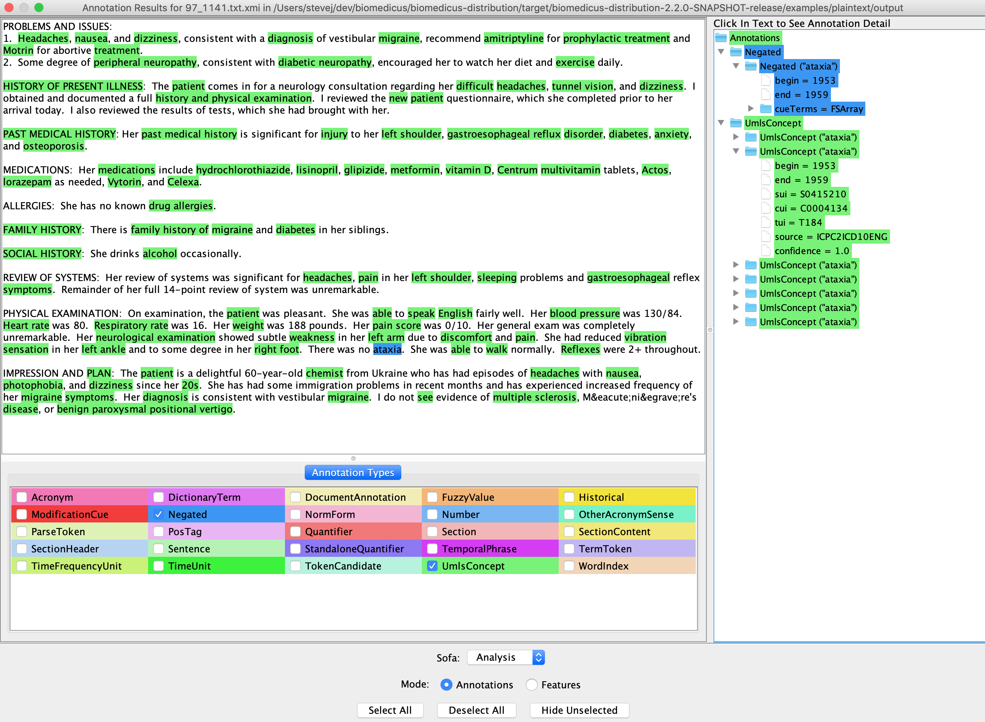
Natural Language Processing (NLP)

Slide 10
Phenotyping
Algorithm for computing new feature
High_Blood_Pressure =
ANY(diagnosis = “I10*”)
ANY(bp_systolic >= 130 OR bp_diastolic >= 80)
AT_LEAST_2(bp_systolic >= 130 OR bp_diastolic >= 80)
LAST_3(bp_systolic >= 130 OR bp_diastolic >= 80)
ANY(Hypertension_Medicine OR HBP_Diagnosis)

Slide 11
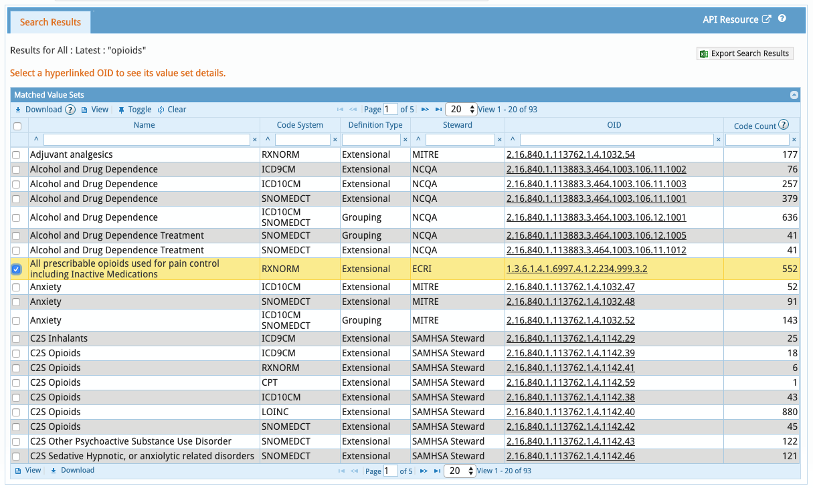
Phenotyping
NLM Value Set Authority (VSAC)
https://vsac.nlm.nih.gov/

Slide 12
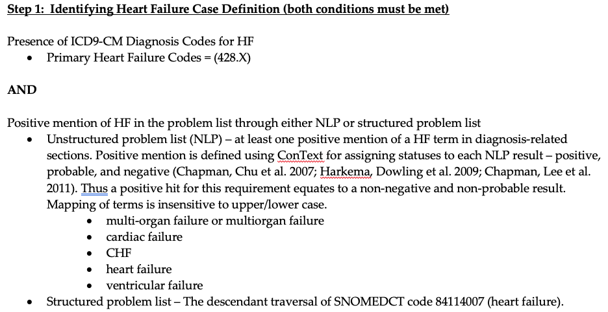
Phenotyping
PheKB - https://phekb.org/

Slide 13
Visualization
Use visualization best practices (Tufte)
Use productive tools
Tell a story

Slide 14
Visualization Best Practices
Tufte's 6 Principles of Graphical Integrity
Representation of numbers should match the true proportions.
Labeling should be clear and detailed.
Design should not vary for some ulterior motive, show only data variation.
To represent money, well known units are best.
The number of dimensions represented should be the same as the number of dimensions in the data.
Representations should not imply unintended context.
Source: Tufte ER. The visual display of quantitative information. Cheshire, CT: Graphics press; 2001 Jan.
Notes:
Because of the variation that inevitably crops up in graphical representations of data, Tufte came up with six principles that are meant to ensure high graphical integrity. They are outlined in his book The Visual Display of Quantitative Information. They are as follows:

Slide 15
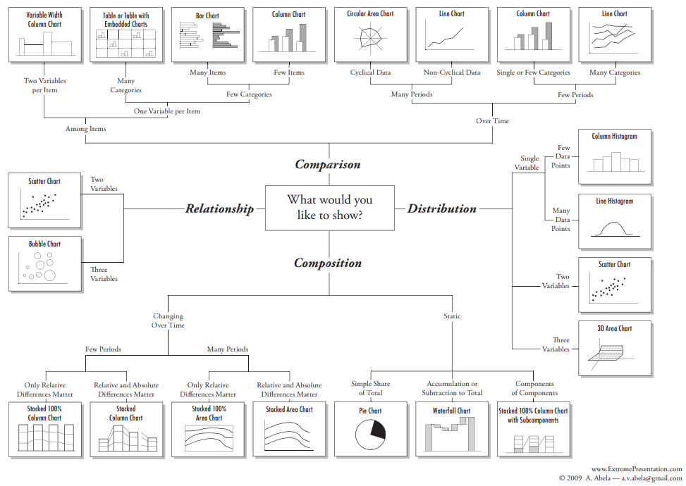
Types of Visualizations
Source: https://extremepresentation.typepad.com/files/choosing-a-good-chart-09.pdf

Slide 16
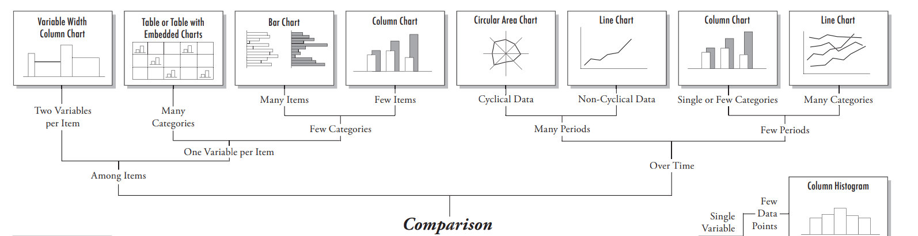

Comparison
Source: https://extremepresentation.typepad.com/files/choosing-a-good-chart-09.pdf

Slide 17
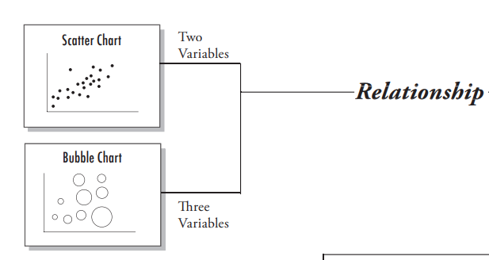

Relationship
Source: https://extremepresentation.typepad.com/files/choosing-a-good-chart-09.pdf

Slide 18

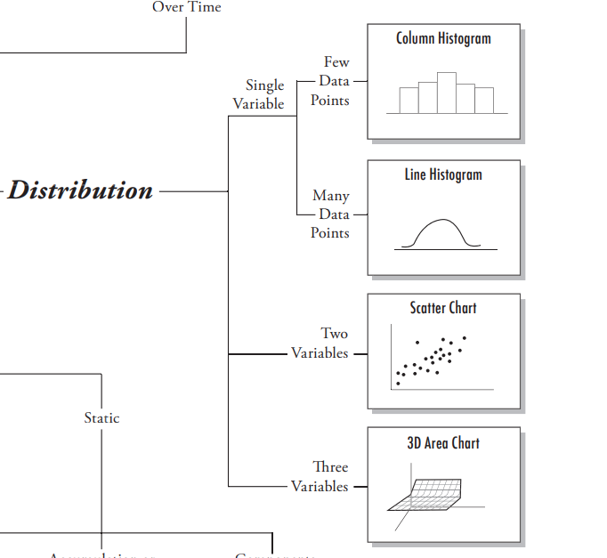
Distribution
Source: https://extremepresentation.typepad.com/files/choosing-a-good-chart-09.pdf

Slide 19

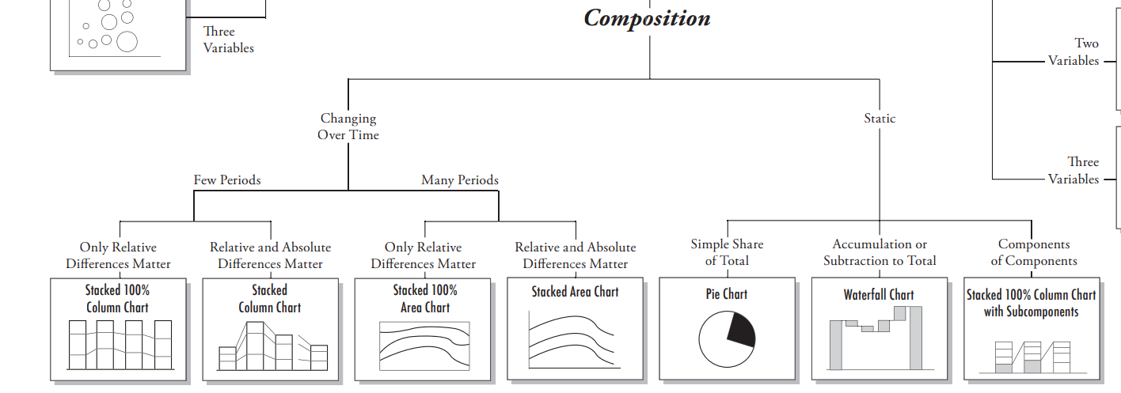
Composition
Source: https://extremepresentation.typepad.com/files/choosing-a-good-chart-09.pdf

Slide 20
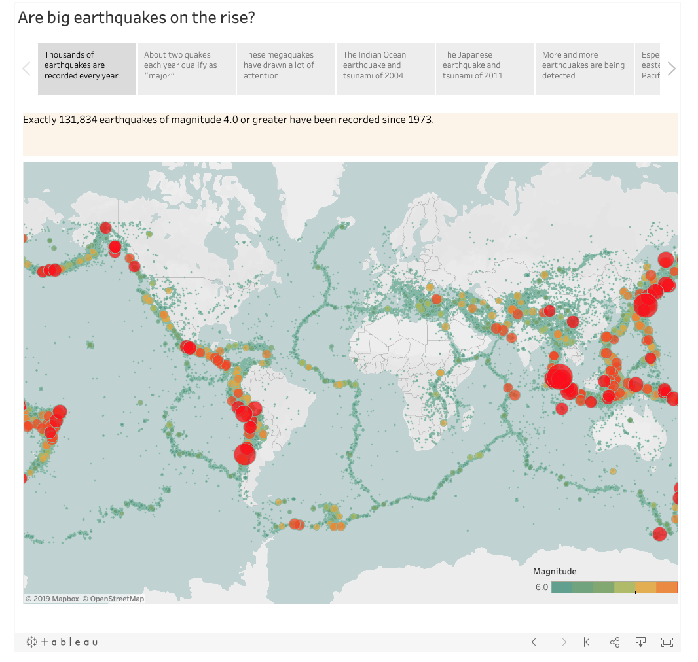
Tell a Story
Use color, size,shape, proportion, progression and text callouts to tell the story
Uses maps to show relationships
Mix different visualizations to show data in the most appropriate manner
Source: Tableau

Slide 21
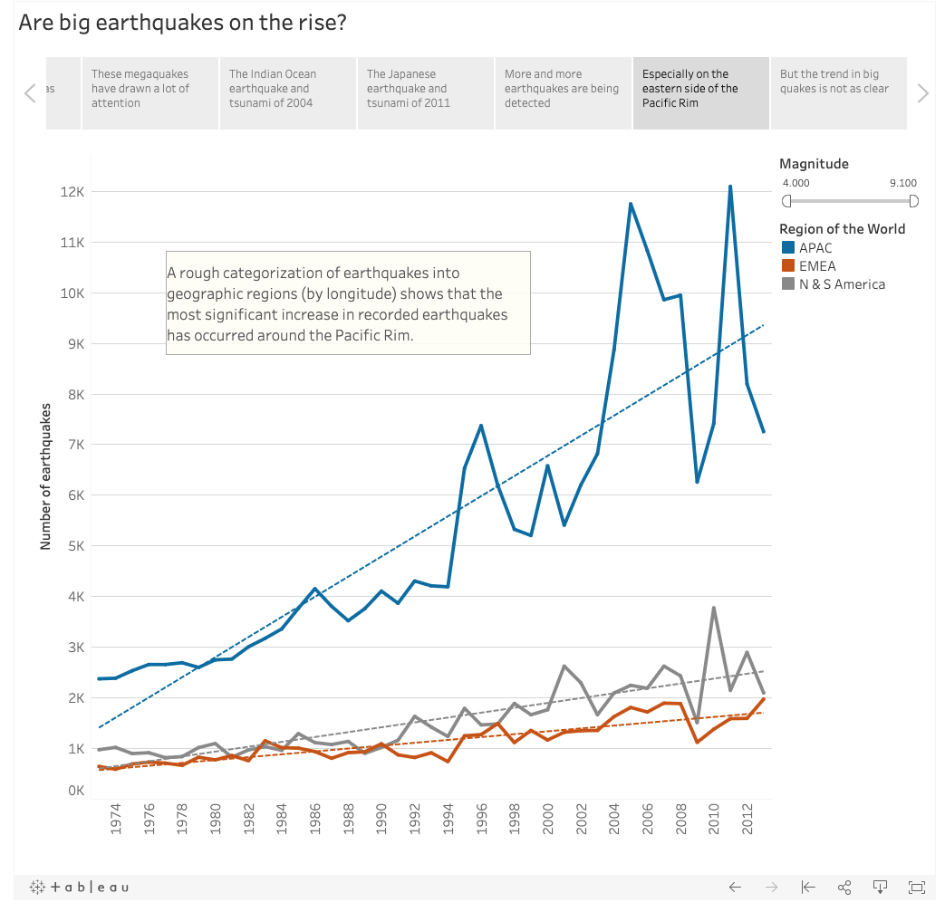
Tell a Story

Slide 22
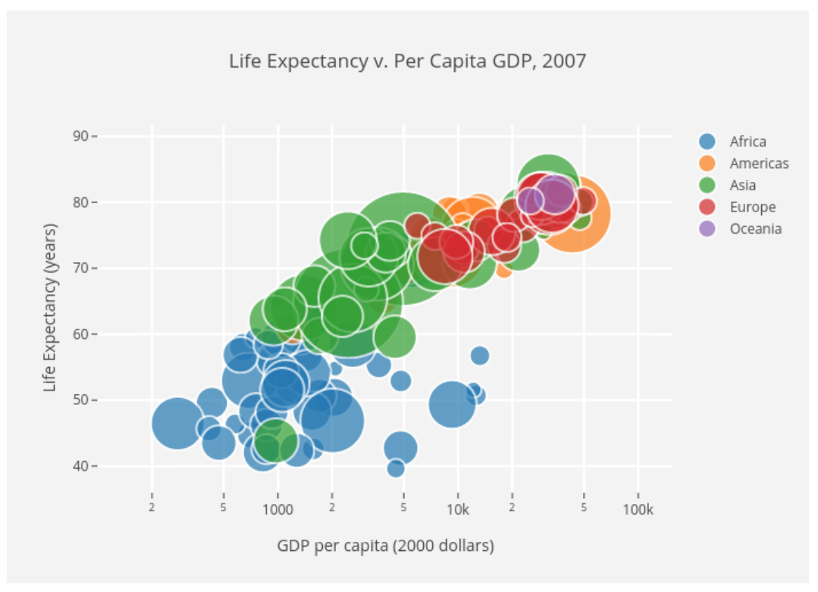
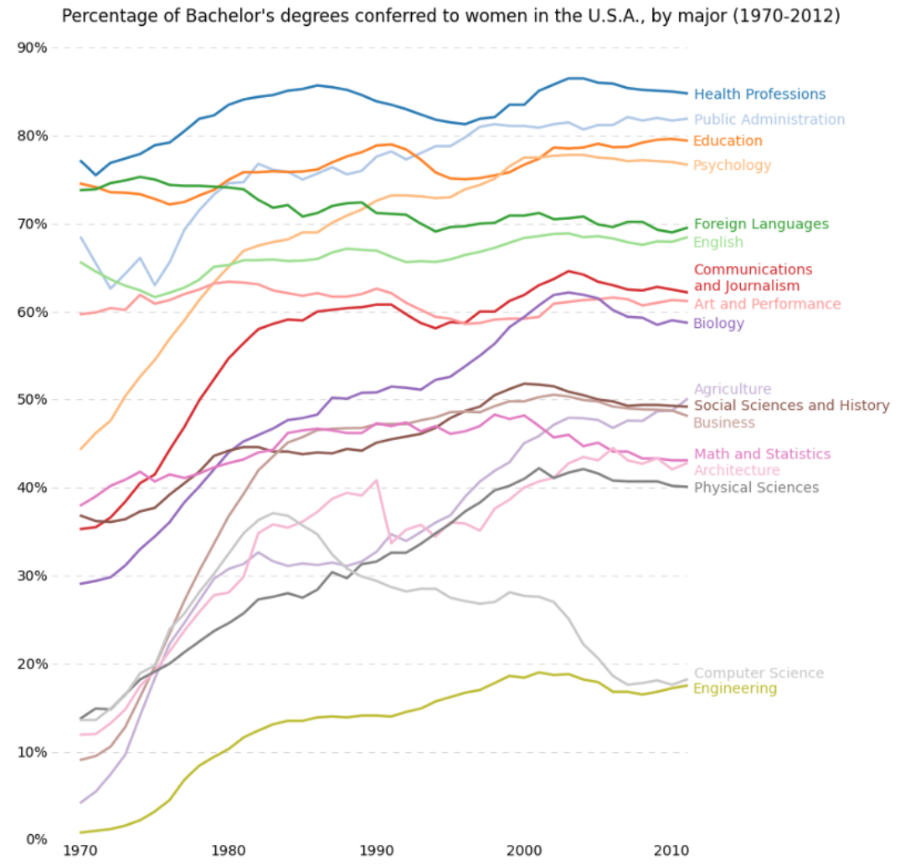
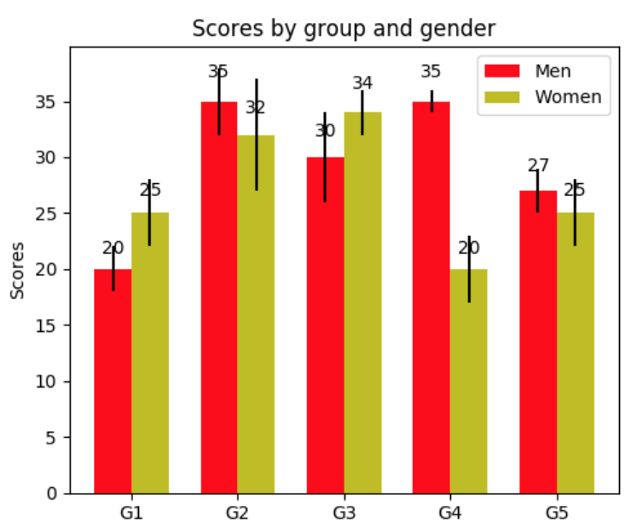
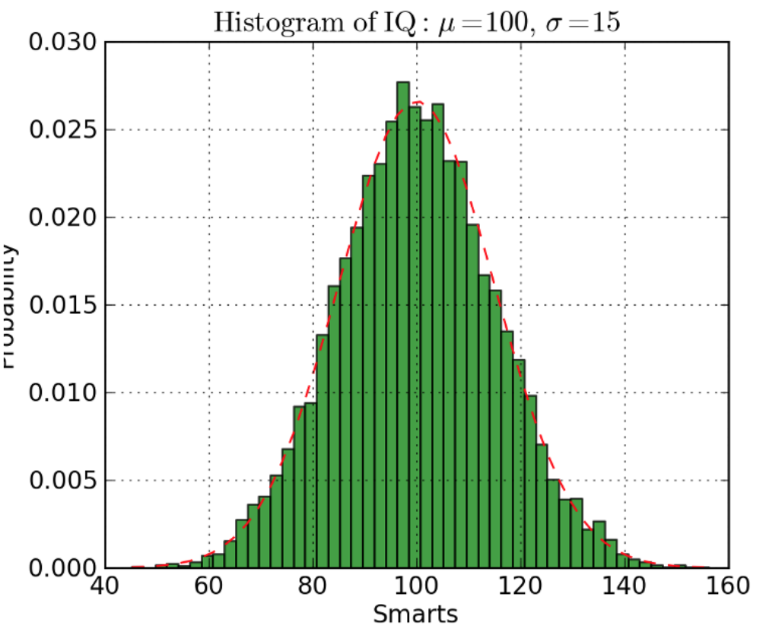
Visualization Tools: Python
Matplotlib – Powerful, complex visualization package
https://matplotlib.org/2.1.1/gallery/index.html
Seaborn – Simplifies Matplotlib, default styles
Bokeh – Interactive visualization in a browser
Line plots
Scatter plots
Bar charts
Histograms
Source: https://towardsdatascience.com/5-quick-and-easy-data-visualizations-in-python-with-code-a2284bae952f

Slide 23
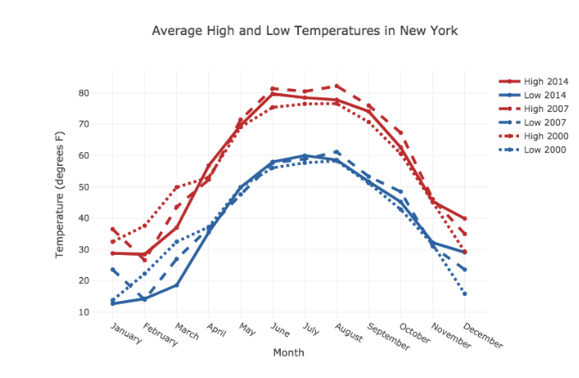
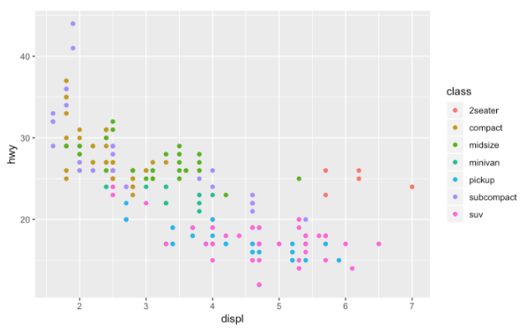
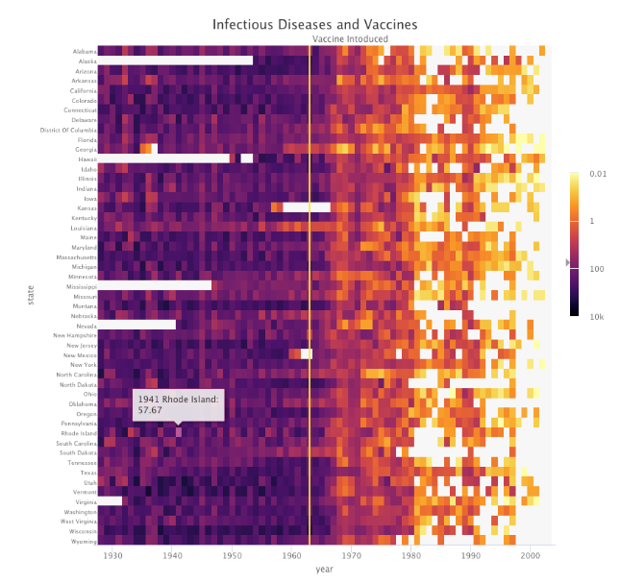
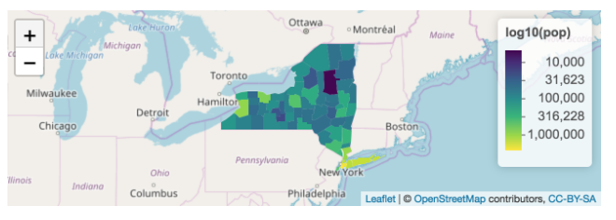
Visualization Tools: R
ggplot2 – Easy but powerful workhorse for visualization
https://www.r-graph-gallery.com/
Plotly – Interactive plotting
Leaflet - Maps
Line plots
Scatter plots
Heat maps
Maps
Source: https://mode.com/blog/r-data-visualization-packages

Slide 24
Visualization Tools: Commercial
Tableau – Easy to use, powerful, expensive
QlikView – Easy to use, fast, expensive
PowerBI – Microsoft ecosystem, simple, powerful, not free
Tableau
QlikView
Power BI
Source: https://www.tableau.com, https://www.Microsoft.com, https://www.qlik.com
Notes:
Integrate with many databases, new features every 6 months, enterprise ready

Slide 25
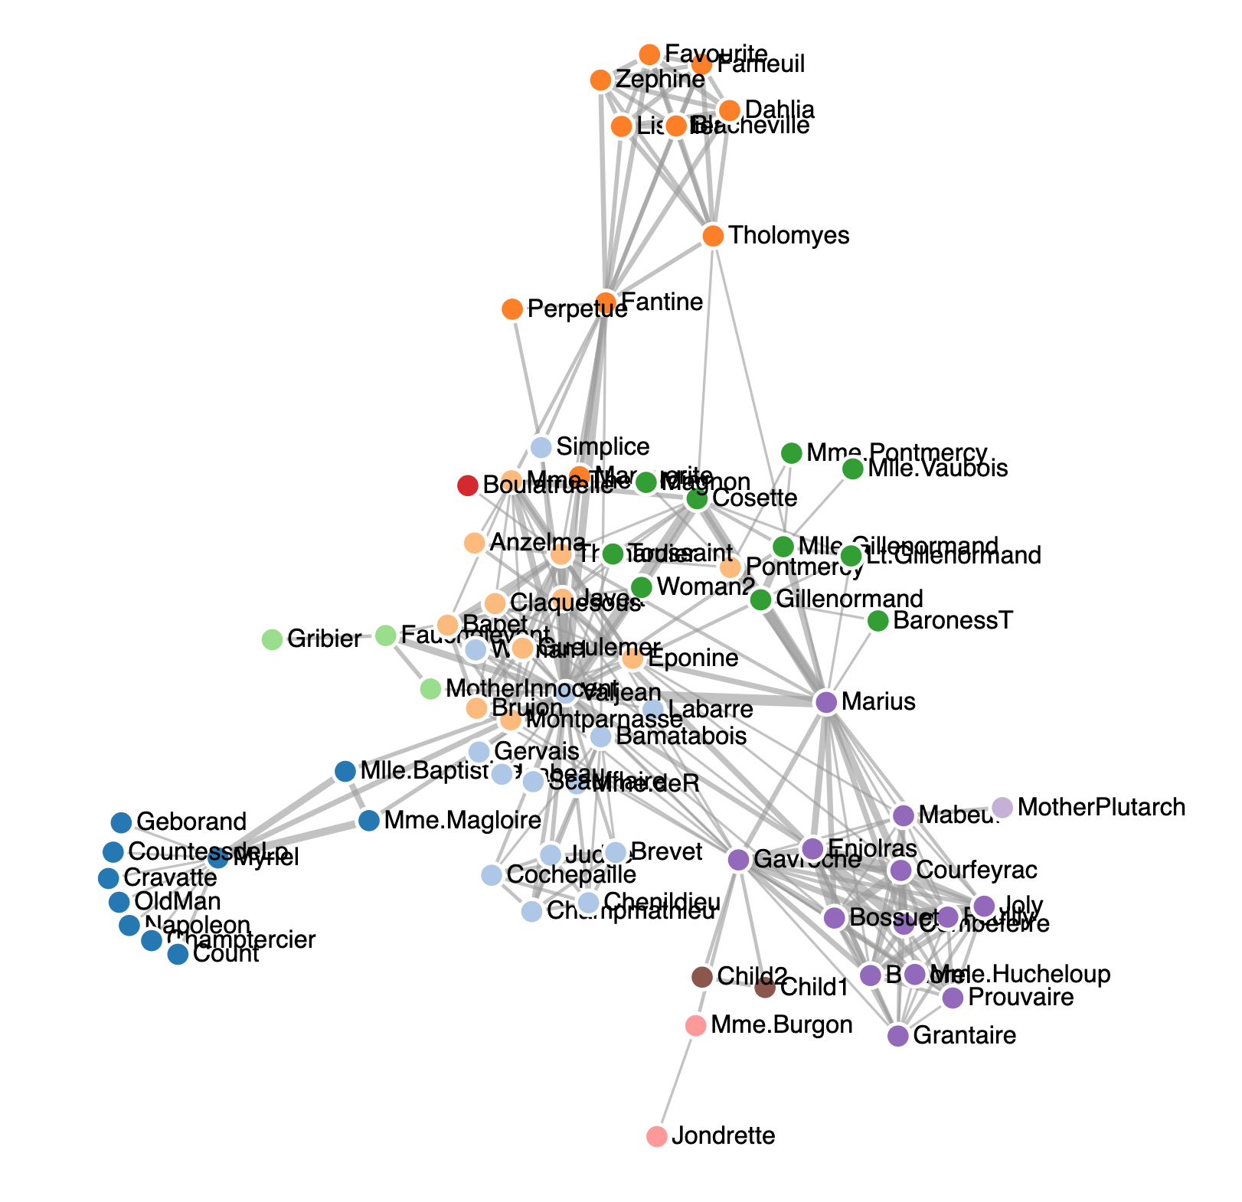
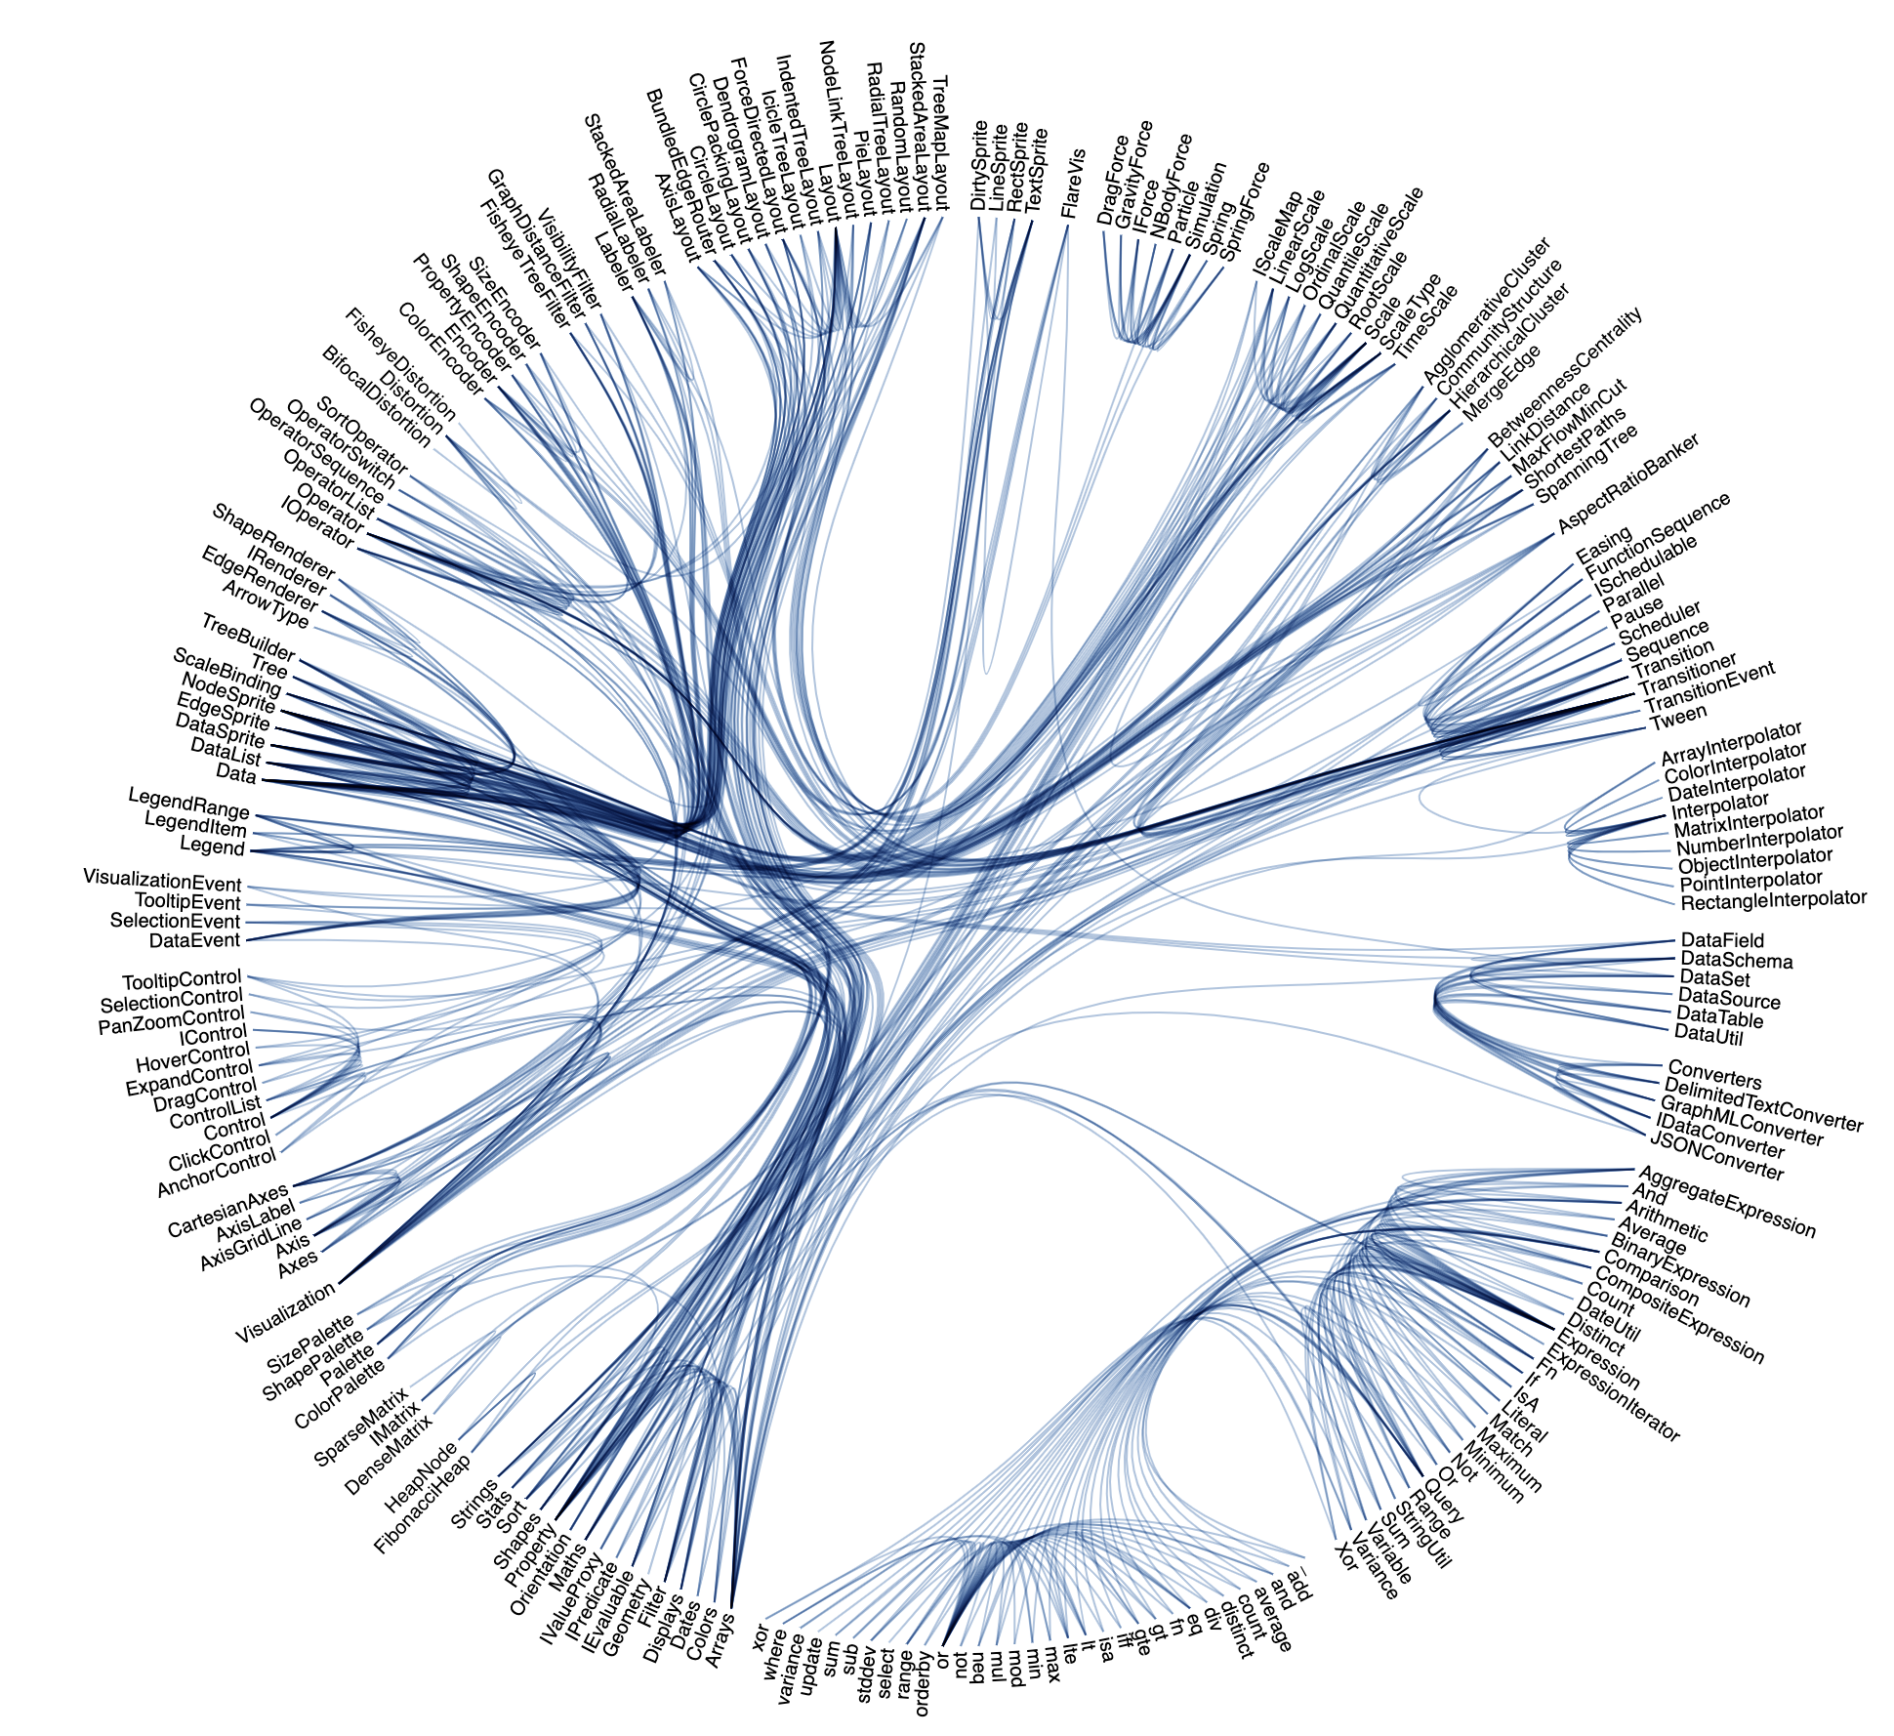
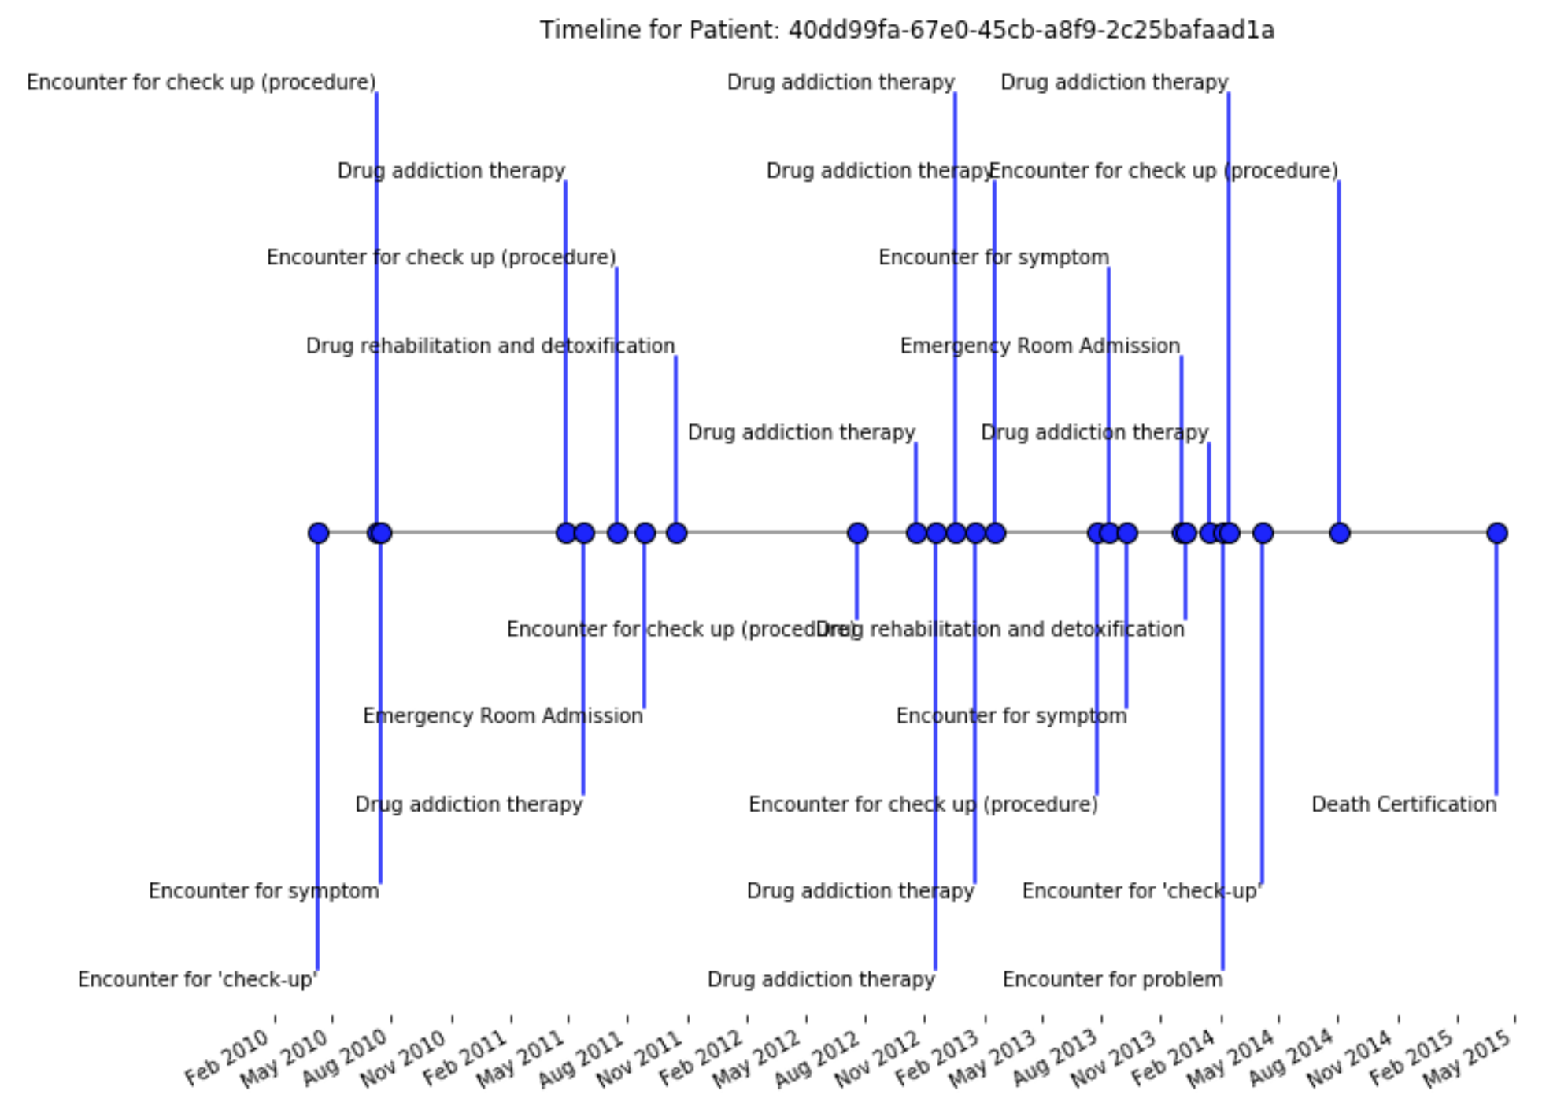
Visualization Tools: Custom
Force Directed Graph – d3
d3 – Custom visualizations using JavaScript
https://d3js.org/ , https://bl.ocks.org/mbostock
Build your own in Python and R
Hierarchical Edge Bundling – d3
Custom Timeline - Python

